Slide 1
Integrated APC-GAN and AttuNet framework for automated pavement crack pixel-level segmentation: A new solution to small training datasets
Comprehensive Exam
by
Tianjie Zhang
Advisory Committee
Yang Lu, Ph.D.
Nick Hudyma, Ph.D.
Dave Zhai, Ph.D.
Alejandro Rosales, MS
May 6, 2022
Notes:
Thanks advisory committee, other faculty, guests, and students.

Slide 2
Emphasis Area: Data Science
Background and Motivation
Research Goals
Proposed Research
Methodology
Preliminary Results
Notes:
Speak out all points

Slide 3
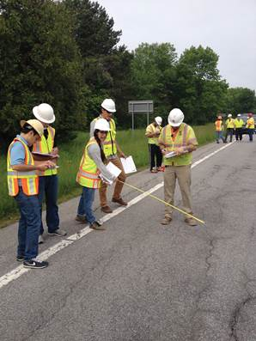
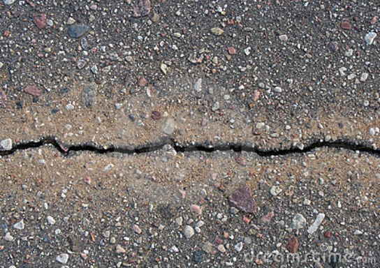
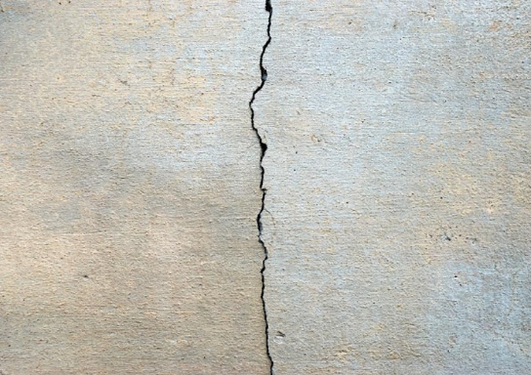
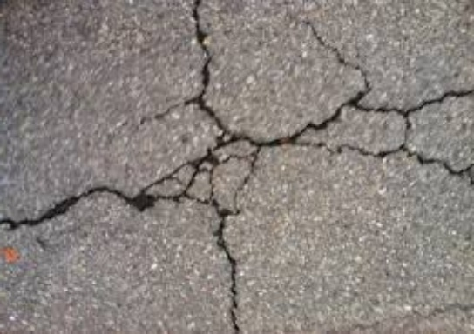
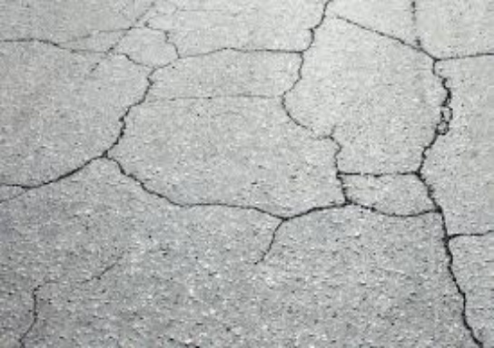
Introduction
Crack has become one of the primary defects in pavement, which seriously affects the service life of pavement.
Traditional inspection:
Cons:
Time-consuming
Labor-intensive
Dangerous
Affect Traffic Flow
Pavement Crack
From: Deep Crack
From:https://www.fhwa.dot.gov/publications/research/infrastructure/pavements/ltpp/15049/007.cfm
Notes:
First, let me introduce the background of this project.
There are several different pavement distresses, such as various cracks, patching, sealing, that occur over the course of a pavement’s service life and can negatively impact the performance and longevity of the structure lifespan. These distresses can occur as a result of loading, environmental conditions, chemicals, and materials used.
The traditional method to determine the number, type, and distribution of defects is often achieved by engineers identifying and counting them manually. However, this method is time consuming, labor intensive and also sometimes dangerous, as it affects the traffic.
A promising new field of interdisciplinary work with computer science being applied to the civil engineering industry, is intelligent pavement defect inspection and identification. If this method is implemented correctly, it could be utilized to identify pavement defects, the severity of the distress, and implement repairs; all through nondestructive methods.

Slide 4

Introduction
Intelligent pavement detection
and identification becomes a significant task.
The training dataset is lacking or uneven, making it insufficient to train an accurate segmentation model.
From: https://www.surveylegend.com/customer-insight/open-ended-survey-questions/
Notes:
First, let me introduce the background of this project.
There are several different pavement distresses, such as various cracks, patching, sealing, that occur over the course of a pavement’s service life and can negatively impact the performance and longevity of the structure lifespan. These distresses can occur as a result of loading, environmental conditions, chemicals, and materials used.
The traditional method to determine the number, type, and distribution of defects is often achieved by engineers identifying and counting them manually. However, this method is time consuming, labor intensive and also sometimes dangerous, as it affects the traffic.
A promising new field of interdisciplinary work with computer science being applied to the civil engineering industry, is intelligent pavement defect inspection and identification. If this method is implemented correctly, it could be utilized to identify pavement defects, the severity of the distress, and implement repairs; all through nondestructive methods.

Slide 5
Introduction
Data augmentation
Crop, Flip, Adjust brightness, contrast, blur…
Trad image-Aug
In 2014, Goodfellow proposed the concept of generative adversarial networks (GANs), which can produce real-like images through a battle between a generator and discriminator.
GAN
Alec Radford proposed deep convolutional generative adversarial networks (DCGANs) based on the conception of GAN, and it showed good representations of images.
DCGAN
Notes:
First, let me introduce the background of this project.
There are several different pavement distresses, such as various cracks, patching, sealing, that occur over the course of a pavement’s service life and can negatively impact the performance and longevity of the structure lifespan. These distresses can occur as a result of loading, environmental conditions, chemicals, and materials used.
The traditional method to determine the number, type, and distribution of defects is often achieved by engineers identifying and counting them manually. However, this method is time consuming, labor intensive and also sometimes dangerous, as it affects the traffic.
A promising new field of interdisciplinary work with computer science being applied to the civil engineering industry, is intelligent pavement defect inspection and identification. If this method is implemented correctly, it could be utilized to identify pavement defects, the severity of the distress, and implement repairs; all through nondestructive methods.

Slide 6
Introduction
Network Structure
Bang, S et al. used ResNet-152 to increase the layers in structure in purpose of increasing the accuracy of cracks identification.
Resnet
The main idea of U-Net is to replace pooling operators by upsampling operators to increase the output resolution. Also, it combines the high-resolution features with the upsampled output to learn more precise information based on small dataset.
U-Net
Notes:
First, let me introduce the background of this project.
There are several different pavement distresses, such as various cracks, patching, sealing, that occur over the course of a pavement’s service life and can negatively impact the performance and longevity of the structure lifespan. These distresses can occur as a result of loading, environmental conditions, chemicals, and materials used.
The traditional method to determine the number, type, and distribution of defects is often achieved by engineers identifying and counting them manually. However, this method is time consuming, labor intensive and also sometimes dangerous, as it affects the traffic.
A promising new field of interdisciplinary work with computer science being applied to the civil engineering industry, is intelligent pavement defect inspection and identification. If this method is implemented correctly, it could be utilized to identify pavement defects, the severity of the distress, and implement repairs; all through nondestructive methods.

Slide 7
Introduction
This paper proposed a framework for pavement crack segmentation which contains an automated pavement crack generative adversarial network (APC-GAN) and a new pixel-level pavement crack segmentation network, AttuNet.
Notes:
First, let me introduce the background of this project.
There are several different pavement distresses, such as various cracks, patching, sealing, that occur over the course of a pavement’s service life and can negatively impact the performance and longevity of the structure lifespan. These distresses can occur as a result of loading, environmental conditions, chemicals, and materials used.
The traditional method to determine the number, type, and distribution of defects is often achieved by engineers identifying and counting them manually. However, this method is time consuming, labor intensive and also sometimes dangerous, as it affects the traffic.
A promising new field of interdisciplinary work with computer science being applied to the civil engineering industry, is intelligent pavement defect inspection and identification. If this method is implemented correctly, it could be utilized to identify pavement defects, the severity of the distress, and implement repairs; all through nondestructive methods.

Slide 8
Data
A DeepCrack dataset was utilized in this work to test the performance of the CNN networks. The DeepCrack dataset is an open-source dataset published in GitHub (https://github.com/yhlleo/DeepCrack).
This dataset consists of 537 RGB crack images with manually annotated segmentations. The image has a resolution of 544 * 384 pixels.
The images are divided into two subsets:
300 images for training
237 images for testing.
Notes:
First, let me introduce the background of this project.
There are several different pavement distresses, such as various cracks, patching, sealing, that occur over the course of a pavement’s service life and can negatively impact the performance and longevity of the structure lifespan. These distresses can occur as a result of loading, environmental conditions, chemicals, and materials used.
The traditional method to determine the number, type, and distribution of defects is often achieved by engineers identifying and counting them manually. However, this method is time consuming, labor intensive and also sometimes dangerous, as it affects the traffic.
A promising new field of interdisciplinary work with computer science being applied to the civil engineering industry, is intelligent pavement defect inspection and identification. If this method is implemented correctly, it could be utilized to identify pavement defects, the severity of the distress, and implement repairs; all through nondestructive methods.

Slide 9
APC-GAN
Notes:
First, let me introduce the background of this project.
There are several different pavement distresses, such as various cracks, patching, sealing, that occur over the course of a pavement’s service life and can negatively impact the performance and longevity of the structure lifespan. These distresses can occur as a result of loading, environmental conditions, chemicals, and materials used.
The traditional method to determine the number, type, and distribution of defects is often achieved by engineers identifying and counting them manually. However, this method is time consuming, labor intensive and also sometimes dangerous, as it affects the traffic.
A promising new field of interdisciplinary work with computer science being applied to the civil engineering industry, is intelligent pavement defect inspection and identification. If this method is implemented correctly, it could be utilized to identify pavement defects, the severity of the distress, and implement repairs; all through nondestructive methods.

Slide 10
AttuNet
Notes:
First, let me introduce the background of this project.
There are several different pavement distresses, such as various cracks, patching, sealing, that occur over the course of a pavement’s service life and can negatively impact the performance and longevity of the structure lifespan. These distresses can occur as a result of loading, environmental conditions, chemicals, and materials used.
The traditional method to determine the number, type, and distribution of defects is often achieved by engineers identifying and counting them manually. However, this method is time consuming, labor intensive and also sometimes dangerous, as it affects the traffic.
A promising new field of interdisciplinary work with computer science being applied to the civil engineering industry, is intelligent pavement defect inspection and identification. If this method is implemented correctly, it could be utilized to identify pavement defects, the severity of the distress, and implement repairs; all through nondestructive methods.

Slide 11
AttuNet
Notes:
First, let me introduce the background of this project.
There are several different pavement distresses, such as various cracks, patching, sealing, that occur over the course of a pavement’s service life and can negatively impact the performance and longevity of the structure lifespan. These distresses can occur as a result of loading, environmental conditions, chemicals, and materials used.
The traditional method to determine the number, type, and distribution of defects is often achieved by engineers identifying and counting them manually. However, this method is time consuming, labor intensive and also sometimes dangerous, as it affects the traffic.
A promising new field of interdisciplinary work with computer science being applied to the civil engineering industry, is intelligent pavement defect inspection and identification. If this method is implemented correctly, it could be utilized to identify pavement defects, the severity of the distress, and implement repairs; all through nondestructive methods.

Slide 12
AttuNet
Notes:
First, let me introduce the background of this project.
There are several different pavement distresses, such as various cracks, patching, sealing, that occur over the course of a pavement’s service life and can negatively impact the performance and longevity of the structure lifespan. These distresses can occur as a result of loading, environmental conditions, chemicals, and materials used.
The traditional method to determine the number, type, and distribution of defects is often achieved by engineers identifying and counting them manually. However, this method is time consuming, labor intensive and also sometimes dangerous, as it affects the traffic.
A promising new field of interdisciplinary work with computer science being applied to the civil engineering industry, is intelligent pavement defect inspection and identification. If this method is implemented correctly, it could be utilized to identify pavement defects, the severity of the distress, and implement repairs; all through nondestructive methods.

Slide 13
AttuNet
Notes:
First, let me introduce the background of this project.
There are several different pavement distresses, such as various cracks, patching, sealing, that occur over the course of a pavement’s service life and can negatively impact the performance and longevity of the structure lifespan. These distresses can occur as a result of loading, environmental conditions, chemicals, and materials used.
The traditional method to determine the number, type, and distribution of defects is often achieved by engineers identifying and counting them manually. However, this method is time consuming, labor intensive and also sometimes dangerous, as it affects the traffic.
A promising new field of interdisciplinary work with computer science being applied to the civil engineering industry, is intelligent pavement defect inspection and identification. If this method is implemented correctly, it could be utilized to identify pavement defects, the severity of the distress, and implement repairs; all through nondestructive methods.

Slide 14
AttuNet
Notes:
First, let me introduce the background of this project.
There are several different pavement distresses, such as various cracks, patching, sealing, that occur over the course of a pavement’s service life and can negatively impact the performance and longevity of the structure lifespan. These distresses can occur as a result of loading, environmental conditions, chemicals, and materials used.
The traditional method to determine the number, type, and distribution of defects is often achieved by engineers identifying and counting them manually. However, this method is time consuming, labor intensive and also sometimes dangerous, as it affects the traffic.
A promising new field of interdisciplinary work with computer science being applied to the civil engineering industry, is intelligent pavement defect inspection and identification. If this method is implemented correctly, it could be utilized to identify pavement defects, the severity of the distress, and implement repairs; all through nondestructive methods.

Slide 15
AttuNet
Notes:
First, let me introduce the background of this project.
There are several different pavement distresses, such as various cracks, patching, sealing, that occur over the course of a pavement’s service life and can negatively impact the performance and longevity of the structure lifespan. These distresses can occur as a result of loading, environmental conditions, chemicals, and materials used.
The traditional method to determine the number, type, and distribution of defects is often achieved by engineers identifying and counting them manually. However, this method is time consuming, labor intensive and also sometimes dangerous, as it affects the traffic.
A promising new field of interdisciplinary work with computer science being applied to the civil engineering industry, is intelligent pavement defect inspection and identification. If this method is implemented correctly, it could be utilized to identify pavement defects, the severity of the distress, and implement repairs; all through nondestructive methods.

Slide 16
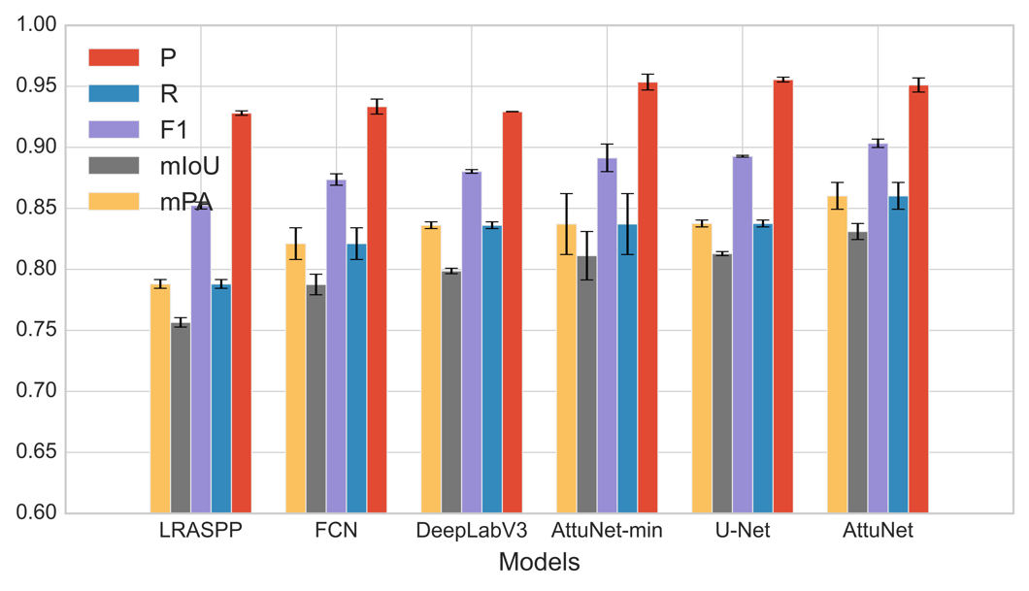
AttuNet
Notes:
First, let me introduce the background of this project.
There are several different pavement distresses, such as various cracks, patching, sealing, that occur over the course of a pavement’s service life and can negatively impact the performance and longevity of the structure lifespan. These distresses can occur as a result of loading, environmental conditions, chemicals, and materials used.
The traditional method to determine the number, type, and distribution of defects is often achieved by engineers identifying and counting them manually. However, this method is time consuming, labor intensive and also sometimes dangerous, as it affects the traffic.
A promising new field of interdisciplinary work with computer science being applied to the civil engineering industry, is intelligent pavement defect inspection and identification. If this method is implemented correctly, it could be utilized to identify pavement defects, the severity of the distress, and implement repairs; all through nondestructive methods.

Slide 17
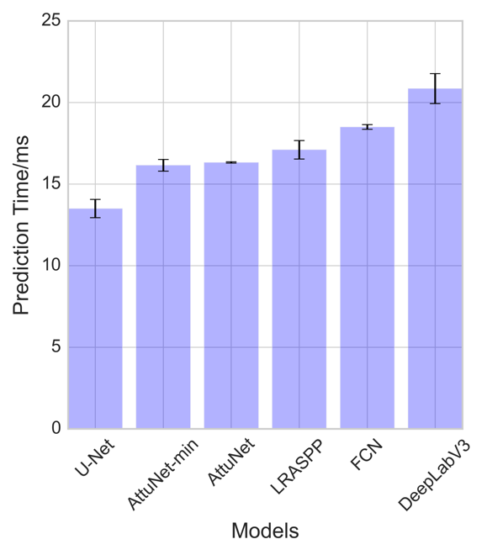
AttuNet
Notes:
First, let me introduce the background of this project.
There are several different pavement distresses, such as various cracks, patching, sealing, that occur over the course of a pavement’s service life and can negatively impact the performance and longevity of the structure lifespan. These distresses can occur as a result of loading, environmental conditions, chemicals, and materials used.
The traditional method to determine the number, type, and distribution of defects is often achieved by engineers identifying and counting them manually. However, this method is time consuming, labor intensive and also sometimes dangerous, as it affects the traffic.
A promising new field of interdisciplinary work with computer science being applied to the civil engineering industry, is intelligent pavement defect inspection and identification. If this method is implemented correctly, it could be utilized to identify pavement defects, the severity of the distress, and implement repairs; all through nondestructive methods.

Slide 18
AttuNet
Notes:
First, let me introduce the background of this project.
There are several different pavement distresses, such as various cracks, patching, sealing, that occur over the course of a pavement’s service life and can negatively impact the performance and longevity of the structure lifespan. These distresses can occur as a result of loading, environmental conditions, chemicals, and materials used.
The traditional method to determine the number, type, and distribution of defects is often achieved by engineers identifying and counting them manually. However, this method is time consuming, labor intensive and also sometimes dangerous, as it affects the traffic.
A promising new field of interdisciplinary work with computer science being applied to the civil engineering industry, is intelligent pavement defect inspection and identification. If this method is implemented correctly, it could be utilized to identify pavement defects, the severity of the distress, and implement repairs; all through nondestructive methods.

Slide 19
AttuNet
Notes:
First, let me introduce the background of this project.
There are several different pavement distresses, such as various cracks, patching, sealing, that occur over the course of a pavement’s service life and can negatively impact the performance and longevity of the structure lifespan. These distresses can occur as a result of loading, environmental conditions, chemicals, and materials used.
The traditional method to determine the number, type, and distribution of defects is often achieved by engineers identifying and counting them manually. However, this method is time consuming, labor intensive and also sometimes dangerous, as it affects the traffic.
A promising new field of interdisciplinary work with computer science being applied to the civil engineering industry, is intelligent pavement defect inspection and identification. If this method is implemented correctly, it could be utilized to identify pavement defects, the severity of the distress, and implement repairs; all through nondestructive methods.

Slide 20
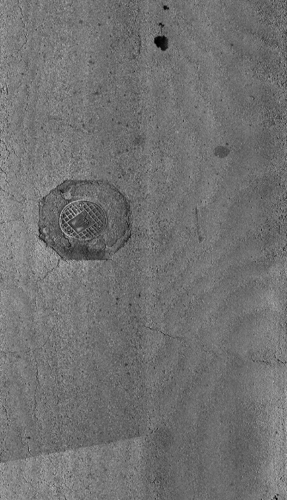
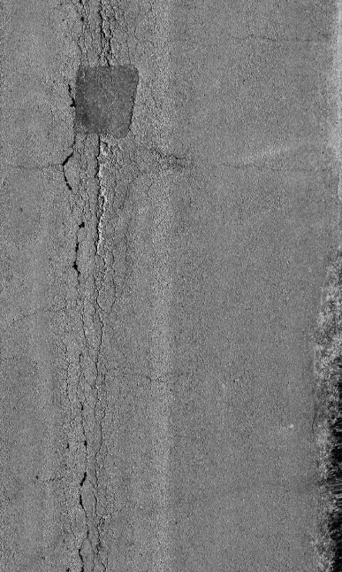
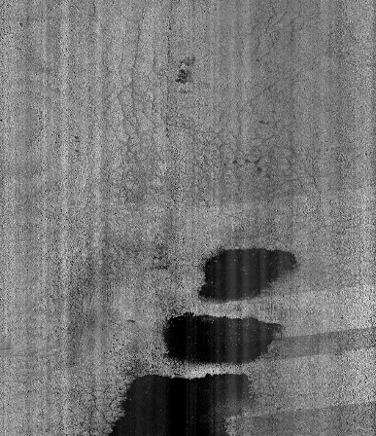
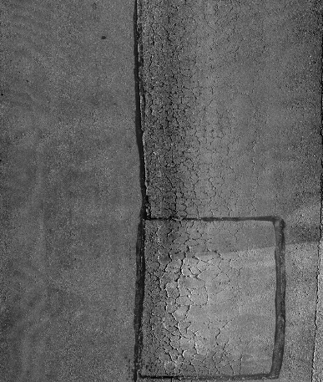

Background
Pavement distresses:
Cracking
alligator
transverse
block
longitudinal
Patching
Sealing
Manholes
Pavement Distress
From: DSPS22
Intelligent pavement detection
and identification becomes a significant task.
Traditional inspection: Time-consuming, Labor-intensive, Dangerous, Affect Traffic
Notes:
First, let me introduce the background of this project.
There are several different pavement distresses, such as various cracks, patching, sealing, that occur over the course of a pavement’s service life and can negatively impact the performance and longevity of the structure lifespan. These distresses can occur as a result of loading, environmental conditions, chemicals, and materials used.
The traditional method to determine the number, type, and distribution of defects is often achieved by engineers identifying and counting them manually. However, this method is time consuming, labor intensive and also sometimes dangerous, as it affects the traffic.
A promising new field of interdisciplinary work with computer science being applied to the civil engineering industry, is intelligent pavement defect inspection and identification. If this method is implemented correctly, it could be utilized to identify pavement defects, the severity of the distress, and implement repairs; all through nondestructive methods.

Slide 21
Notes:
Speak out all points

Slide 22
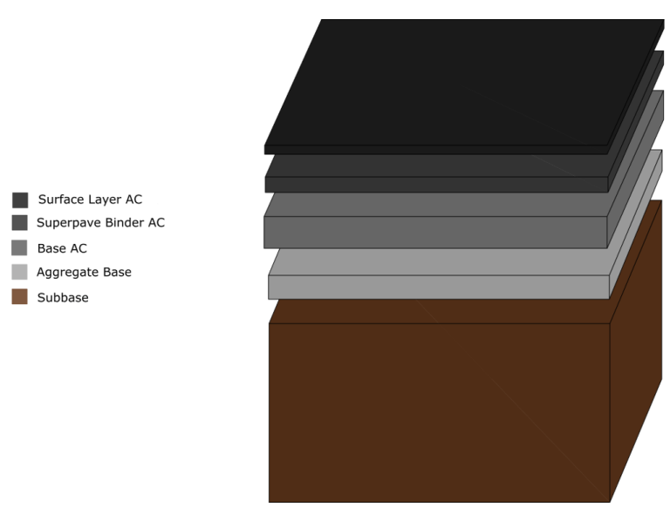
Pavement
What is Pavement:
Transportation capabilities
Goods, people, materials…
Often with vehicle
Application:
Roads
Freeways
Biking and walking
Transportation means between two places
Components of Surface Layer:
Aggregate
Asphalt Binder
Notes:
As we are all familiar at this point, pavement is the structure used to transport materials, goods, or people to different locations, often with vehicles of some sort.

Slide 23
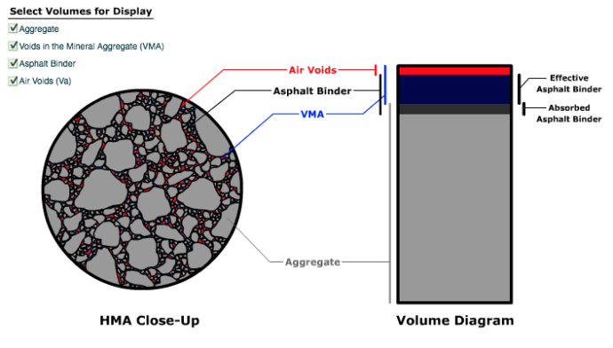
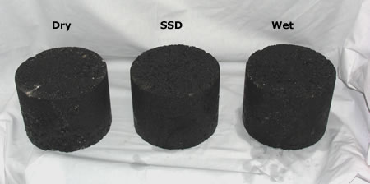
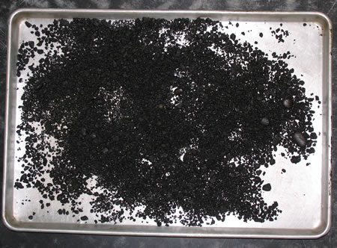
Mix Design
Mix influences
Aggregate properties
Air voids
Asphalt content
Mix verification
Theoretical Max Specific Gravity (Gmm)
Bulk Specfic Gravity (Gsb)
Notes:
all of these factors have a big influence on the mix performance.
Superpave was developed in 1984 to improve the
uses volumetric verification, such as specific gravity, air voids, absorption, etc..

Slide 24
Mix Design - SuperPave
Marshall Mix Design
SuperPave
Superior Performing Asphalt Pavements (1984)
Volumetric verification
Target AC @ 4% air voids
Superpave Gyratory Compactor (SGC)
Predictive Performance Engineered Mix Design

Slide 25
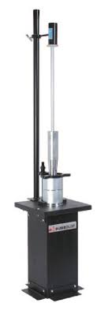
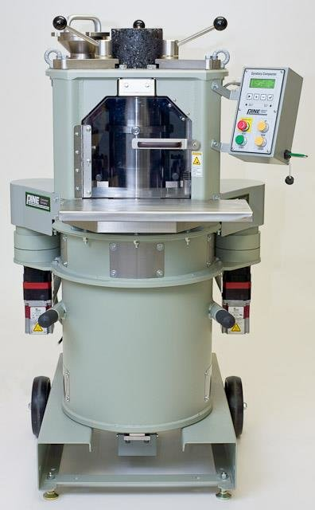
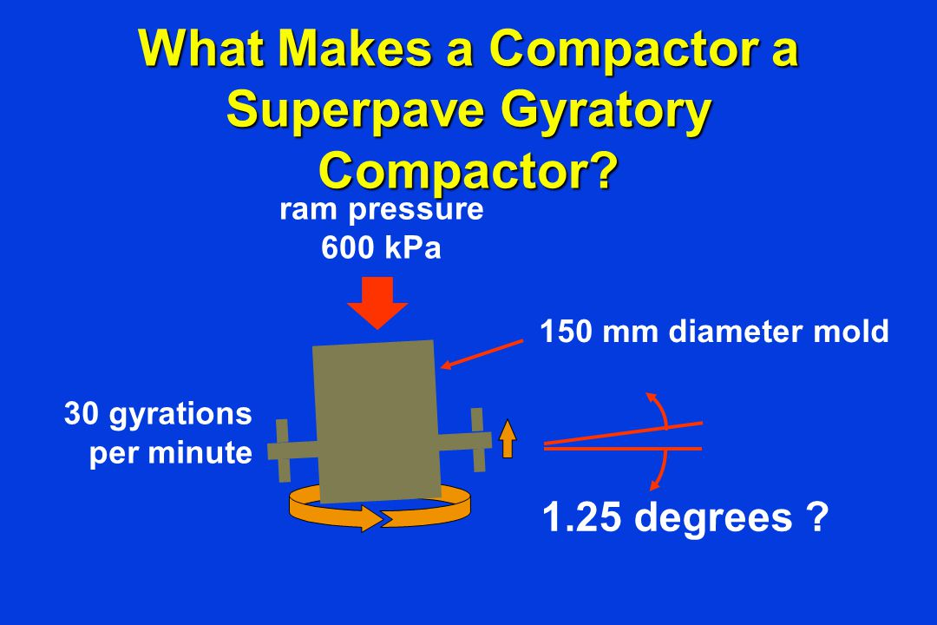

Slide 26
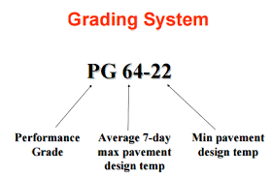
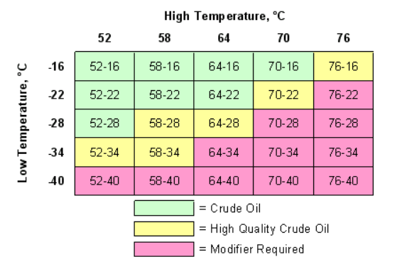
SuperPave Performance Grading

Slide 27
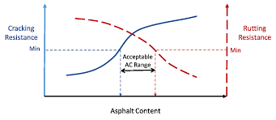
Mix Design – BMD
Balanced Mix Design (BMD)
Index based Performance Engineered Mix Design
Volumetric + performance verification
Performance testing
Cracking
Rutting
** Good performance vs. good mix characteristics **

Slide 28

BMD Benefits
Volumetric Problems:
Specific criteria
Overlay applications
Mix location
New/recycled material
Optimum performance
BMD solutions:
Extend/optimize service life
Climate Change
Economic savings
Cheaper binder + improved mix properties

Slide 29
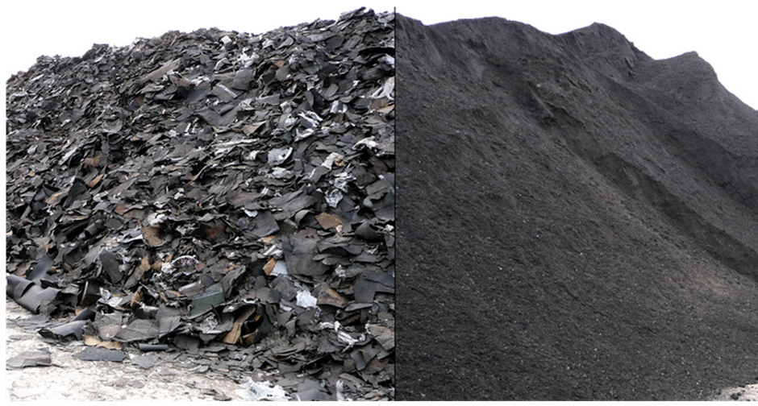
RAP and it’s contribution
Recycled Asphalt Pavement (RAP)
Milling and crushing existing roads
Surface AC 100% recyclable!
Available aged RAP binder
Recycled aggregate
RAP benefits
Economic
Environmental
Notes:
These are concrete characteristics
Speak out all points in brief
*Can be skipped in the concrete specialized presentation

Slide 30
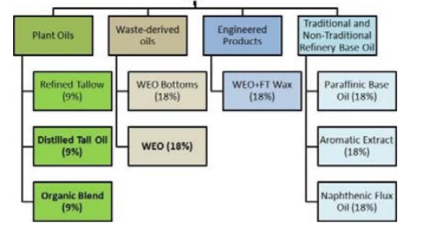
Challenges and Solutions
Problems with High RAP
Variability – source and properties
Available aged RAP binder
Gradation
Cracking
Rutting
Rejuvenators
Revitalizes aged RAP binder
Degree of dispersion/blending

Slide 31
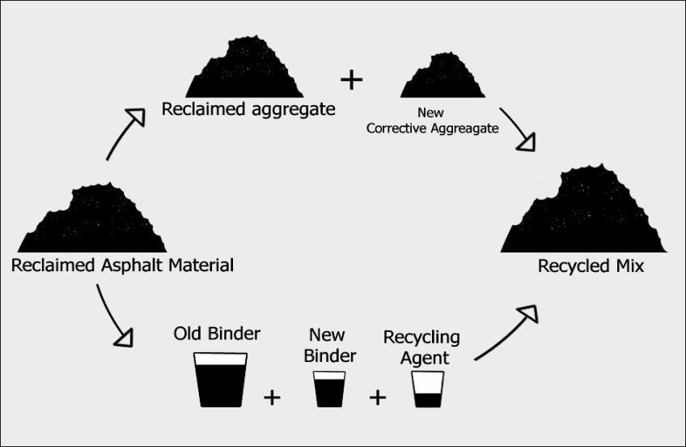

Slide 32
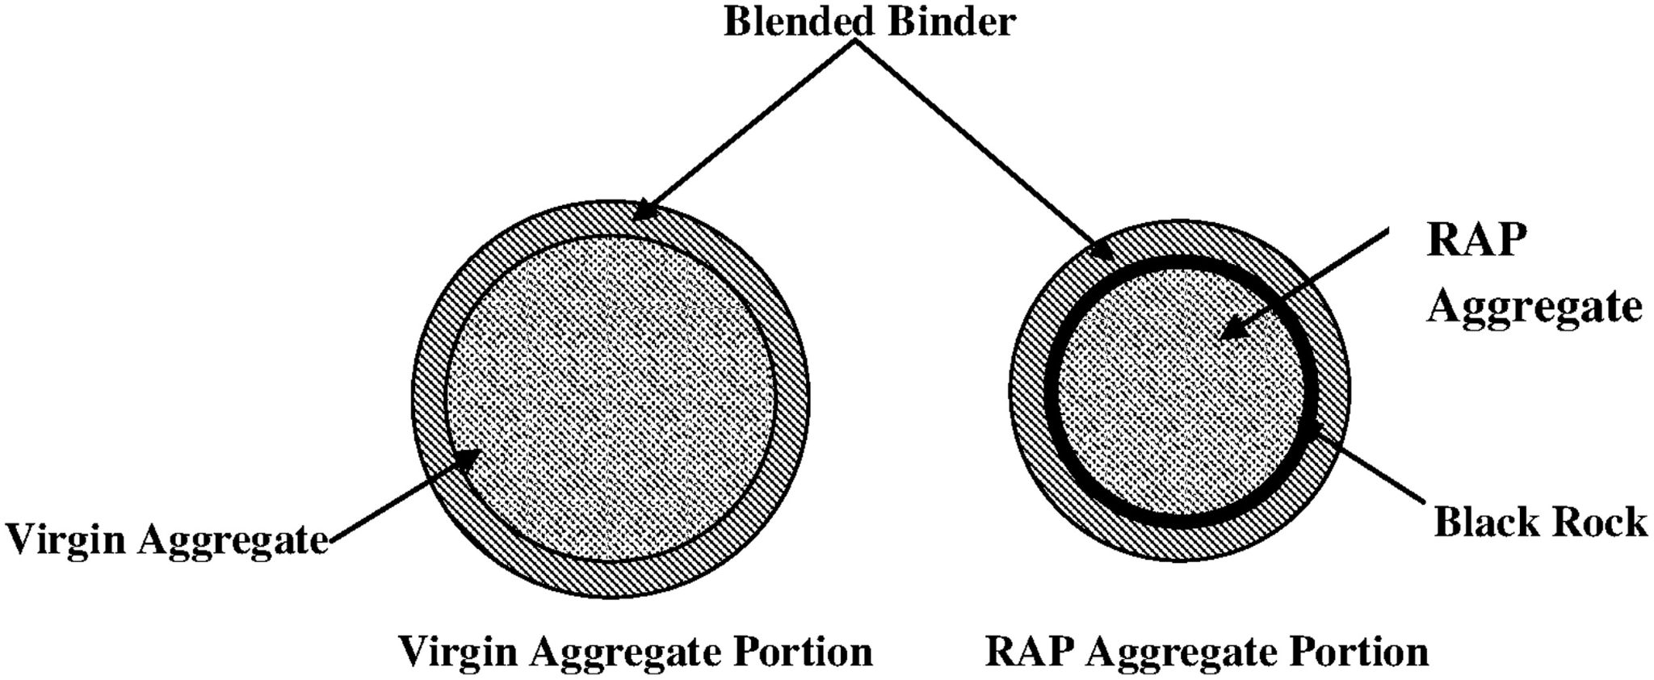
RAP + Rejuvenator uncertainty
RAP binder
Available aged binder
RAP binder properties
Oxidation maltenes fuse asphaltenes
Increase stiffness, less ductile
low in oily maltenes
high in very stiff asphaltenes
Rejuvenator
Softens RAP binder
Degree of blending
Binder activation
Perform as intended
Notes:
High amount of uncertainty associated with high RAP mixes.
maltenes - the ‘glue’ portion of the pavement mix
asphaltenes - responsible for pavement rigidity

Slide 33
Current Practice
‘High’ Recycled Asphalt Pavement (RAP)
0-17% RAP No adjustment needed
17-30% RAP Bump binder grade down one
30% RAP and above need blending chart (‘High’ RAP)
ITD
Upto 30% RAP replacement allowed
No limit previously field problems

Slide 34
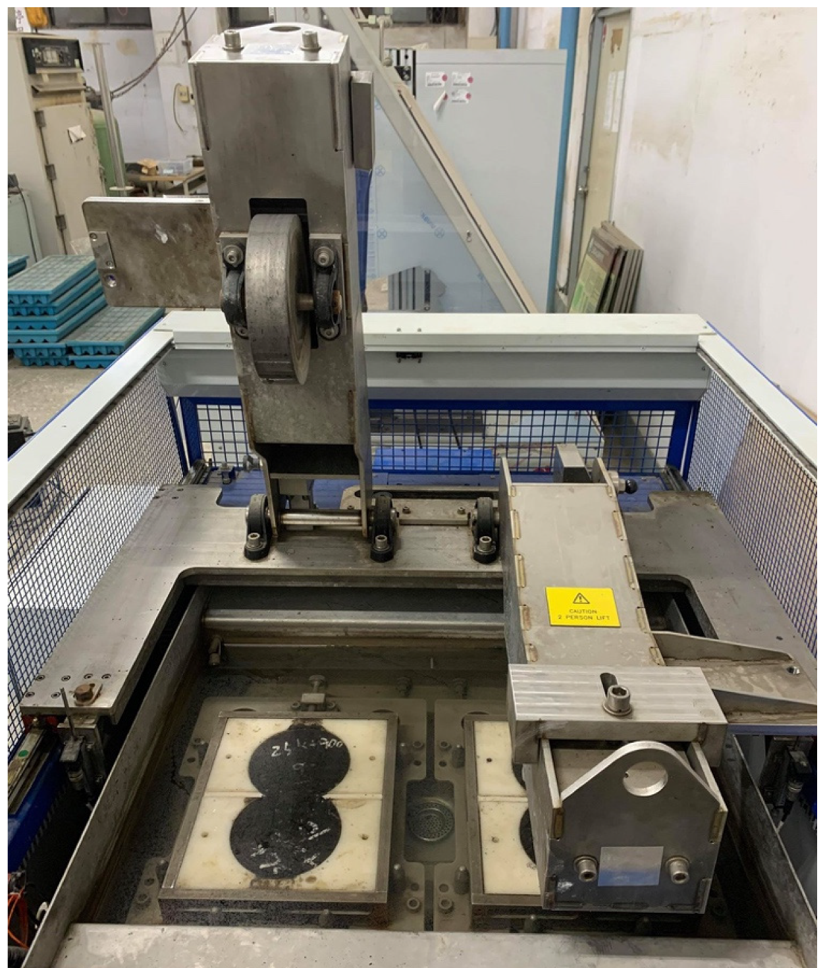
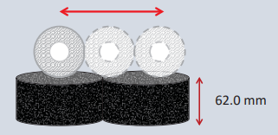
Performance Testing - HWTT
Hamburg Wheel Tracking Test (HWTT)
Water bath @ 50℃
703 + 4.5 N force
< 10 mm rut depth within 15,000 passes
20,000 total passes
150 mm diameter, 62 mm height
Air voids: 7% + 0.5%
Notes:
** include brief history of other tests

Slide 35
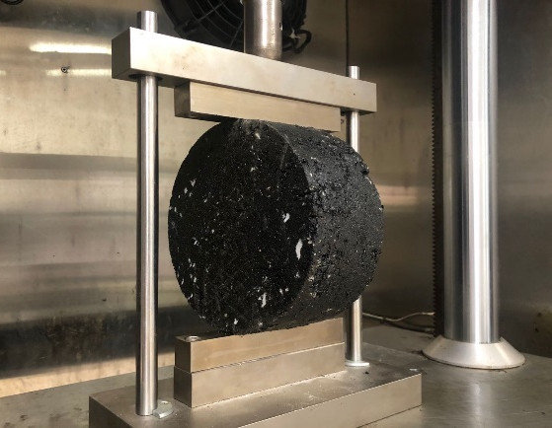
Performance Testing - IDEAL-CT
Indirect Tension Asphalt Cracking Test (IDEAL-CT)
Input sample parameters and dimensions
Displacement: 50 + 2 mm/min
Intermediate temp: 5℃ - 35℃
Load vs. Deformation with time curve
Output CTindex - cracking resistance
Benefits!

Slide 36
Research Goals
Notes:
Speak out all points

Slide 37
Research Goals and Questions
Evaluate the effect of rejuvenators in improving the performance of asphalt mixtures with high RAP contents.
Do the rejuvenators effectively soften and blend with the aged RAP binder to reach a balanced mix?
2. Apply Balanced Mix Design (BMD) to optimize mix performance.
Does implementing a BMD for high RAP mixes prove to be an effective method of mix design?
3. Study economic savings from using rejuvenators and high RAP.
Does the use of rejuvenators in high RAP mix have significant economic benefits? If so, how much?
4. Develop thresholds for performance testing with high RAP mixes.
Are the current ITD performance thresholds reasonable? What should they be adjusted to and why? Specifically IDEAL-CT.

Slide 38
Proposed Research
Notes:
Speak out all points

Slide 39
Proposed Research Plan Part One
Literature Review
Materials Testing
Available Asphalt
RA1/RA2 dose
Virgin Asphalt
Virgin Aggregate
Rejuvenators
RAP
Blending Charts
Gradation
HMA Mix
Design

Slide 40
Proposed Research Part Two
HMA Mix Design
Virgin/Control Mix Design
RAP Mix Design
Mix Gradation
Asphalt Content (%)
25% RAP
50% RAP
70% RAP
100% RAP
RA1 &
RA2
PG 64-34
IDEAL-CT & HWTT Results

Slide 41
Proposed Research Part Three
IDEAL-CT &
HWTT Results
Virgin/Control
Results
Compare
RAP Mix
Results
Data
Analysis
Trends
Duplicates
Future
Research

Slide 42
Project Scope
Starting point:
RAP percentages: 0% (control), 25%, 50%, 70%, 100%
Virgin Asphalt: PG 70-28
RAP properties:
RAP: PG 82-16
Available AC = 5.3%
2 rejuvenators:
1 bio-based (RA1) dose = 8.3% (weight of RAP)
1 petroleum based (RA2) dose = 11.3 % (weight of RAP)
(+1 other blend if time permits)
Performance test parameters:
Rutting (HWTT)
Cracking (IDEAL-CT)

Slide 43
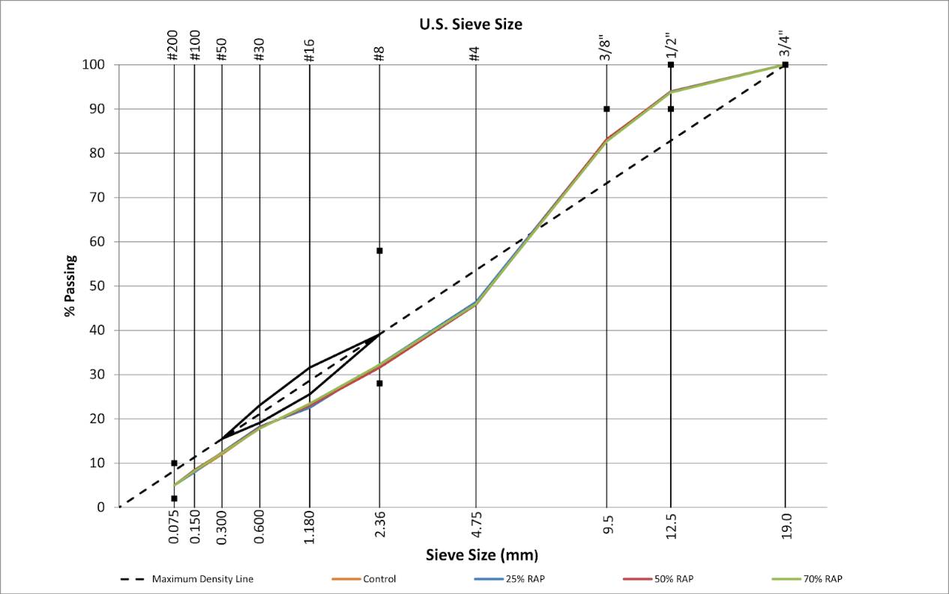
Key Consistencies
Overall AC = 5.3%
Virgin Binder = PG 70-28
Gradation:

Slide 44
Testing matrix - Performance
Table 1: Testing Matrix Performance Testing Plan
 | RA 1 | RA 2
0% (control / virgin) | — | —
25% RAP - with RA’s
25% RAP - with PG 64-34 | — | —
50% RAP
70% RAP
HWTT - requires 4 samples (62 mm height, 7.0 + 0.5% air voids)
IDEAL-CT - requires 3 samples average (7.0 + 0.5% air voids)
Total samples- 56 samples

Slide 45
Asphalt Binder Blend Testing
Table 2: Binder Blend Testing
 | Blend1 (RA1 + RAP binder) | Blend2 (RA2 + RAP binder) | Virgin Binder
BBR:m-value
DSR:G*/sin(𝛅)
FTIR Spec.:
Fourier Transform Infrared (FTIR)
Dynamic Shear Rheometer (DSR)
Bending Beam Rheometer (BBR)

Slide 46
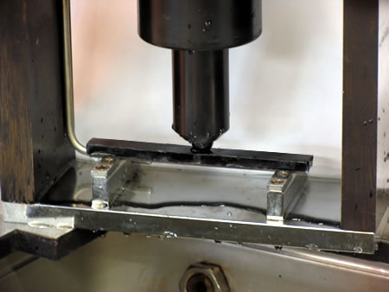
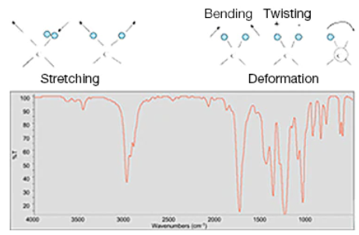
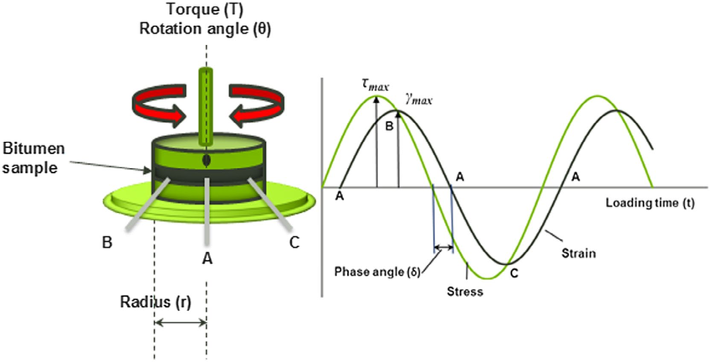
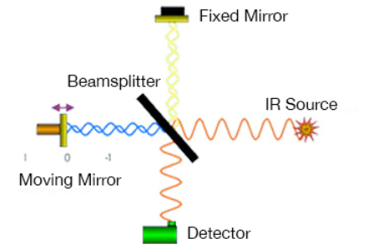
Binder Testing

Slide 47
Phase 1 Outcomes:
Blending charts
25%, 50%, and 70% RAP
RA1 and RA2
Performance criteria comparison for each combination (rut depth and CT-index)
Compare to control mix performance
Initial trends of mix design
Chemical IR comparison of blends to virgin
Binder property comparison

Slide 48

Next Phase
Duplicates
Results in BMD graph (rut vs. crack vs. rejuvenator dose)
100% RAP mix
RA3
Next phase determined with data trends

Slide 49
Methodology
Notes:
Speak out all points

Slide 50
Standards and Process
Short Term Sample Conditioning -
AASHTO T 324 => AASHTO R 30 => AASHTO 312
SuperPave Volumetric Mix Design - AASHTO M 323, R 35 -17
Theoretical Max Specific Gravity (Gmm) - AASHTO T 290-20
Superpave Gyratory Compactor - AASHTO T312-19
Hamburg Wheel Tracking Test - AASHTO T 324-19
Cracking Tolerance Index @ Intermediate Temperature - ASTM D8225 - 19

Slide 51
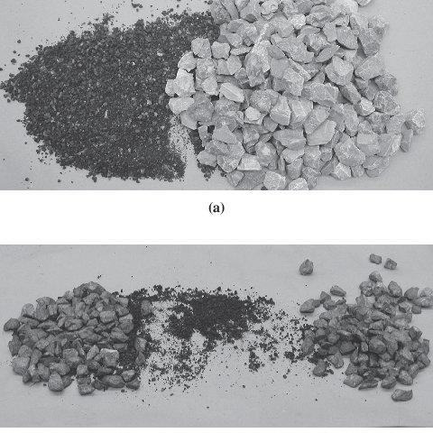
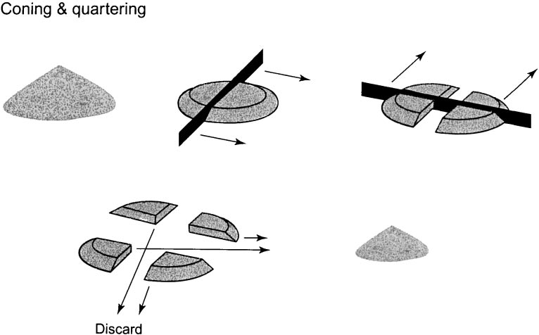
Aggregate & RAP Batching
Virgin Preparation
Sieved (Particle Size Distribution)
½”, ⅜”, No. 4, 8, 16, 30, 50, 100, 200, P200
RAP Preparation
RAP- CA (> No.4), FA (<No.4)
RAP mix, size down, and APEX

Slide 52
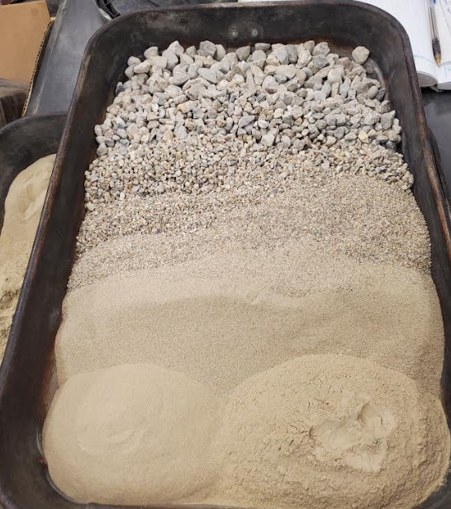
Sample Preparation
Pre-conditioning - 2 hrs
Mixing
Conditioning - 4 hrs
Compaction
Volumetrics check
Testing
Notes:
in order to eliminate segregation and clumping, each fraction (coarse and fine) RAP material was first split and mixed using a ribbon splitter, then was reduced in sample size using the splitter. Then, Using the APEX method, RAP CA and FA is weighed to the appropriate proportions.
RAP material was not sieved out all the way, just above and below the No. 4 sieve. This is due to variation between fine and coarse RAP particles and their available aged RAP binder for each.

Slide 53
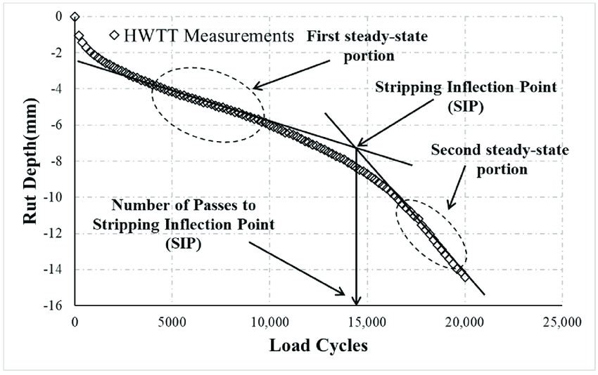
Performance Testing HWTT
HWTT:
Rut depth (mm) < 10mm in 15,000 passes
Rut resistance
Stripping Inflection Point
Permanent strain
Creep & Damage stage of loading

Slide 54
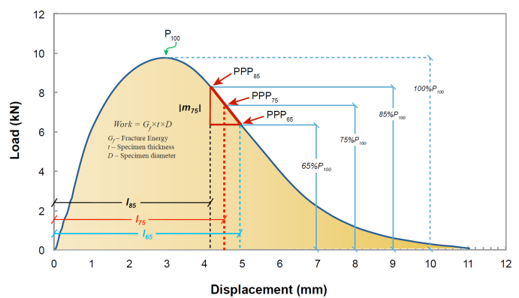
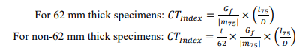
Performance Testing IDEAL-CT
CTindex
Fracture Energy
Applied Load
Vertical deformation (mm)
Sample Dimensions
Coefficient of Variation (COV)
Variation range
ANalysis Of VAriance (ANOVA)

Slide 55
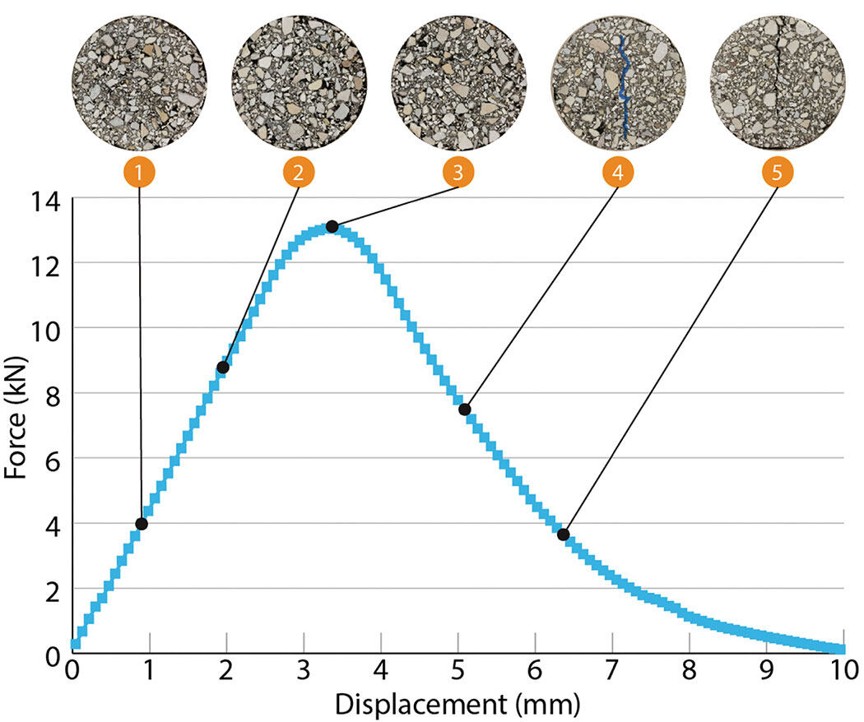
Performance Testing IDEAL-CT

Slide 56
Preliminary Results
Notes:
Speak out all points

Slide 57
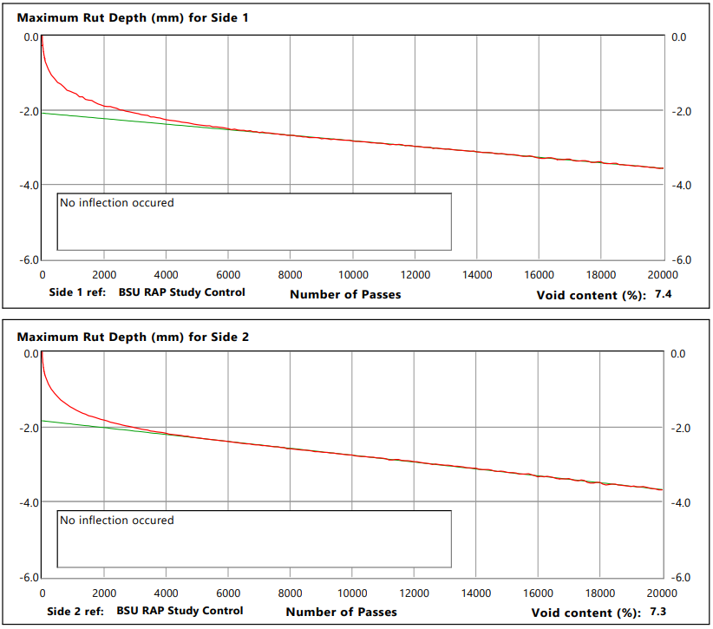
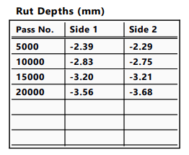
Virgin/Control Mix
HWTT:
No stripping
Under 4mm rut depth
Consistent results

Slide 58
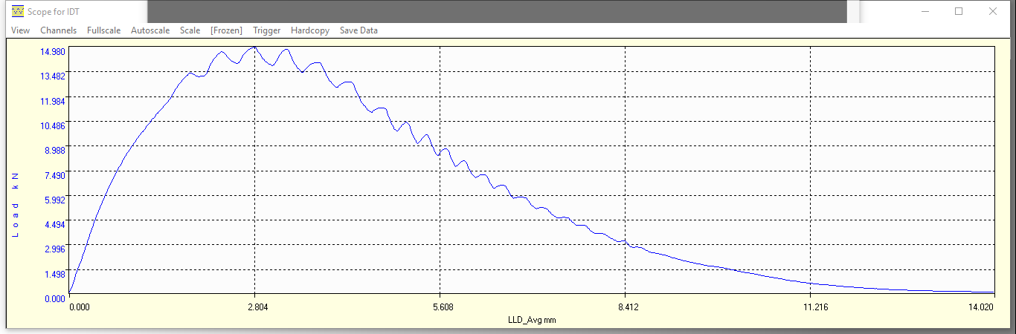
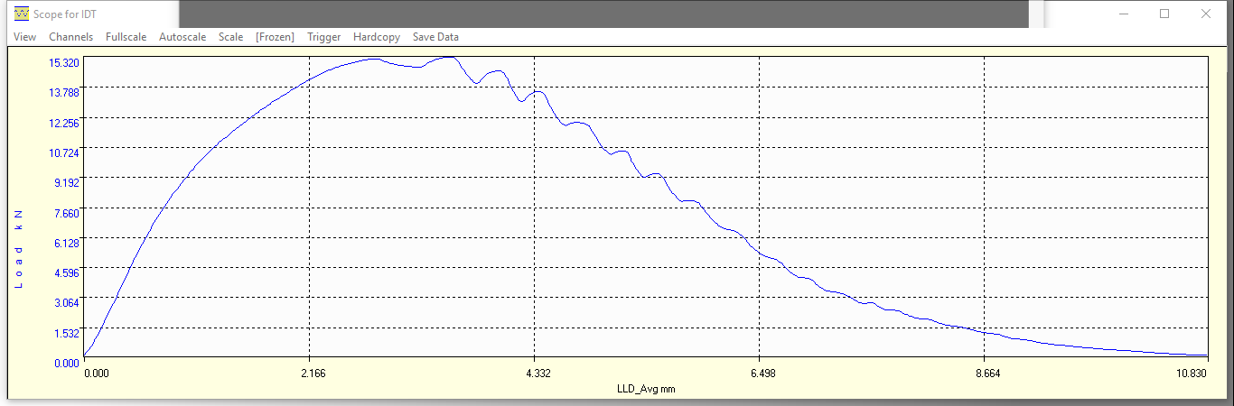
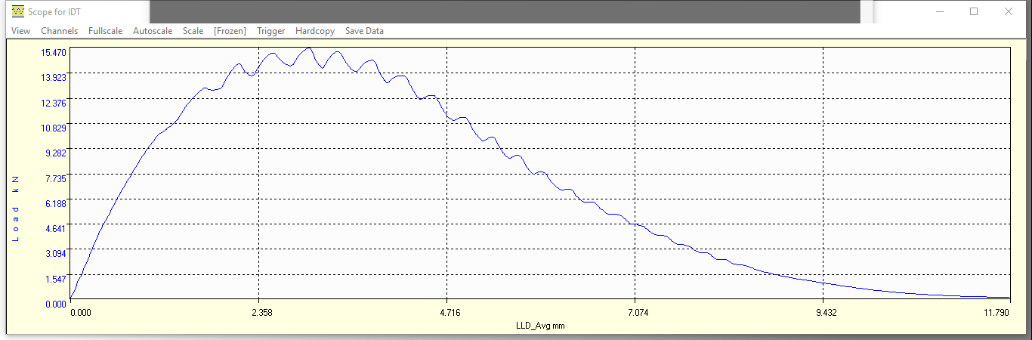
Virgin/Control Mix Cont.
IDEAL-CT
CTindex = 89.7 (avg of 3)
Above current ITD spec.
Good control comparison
Consistent

Slide 59
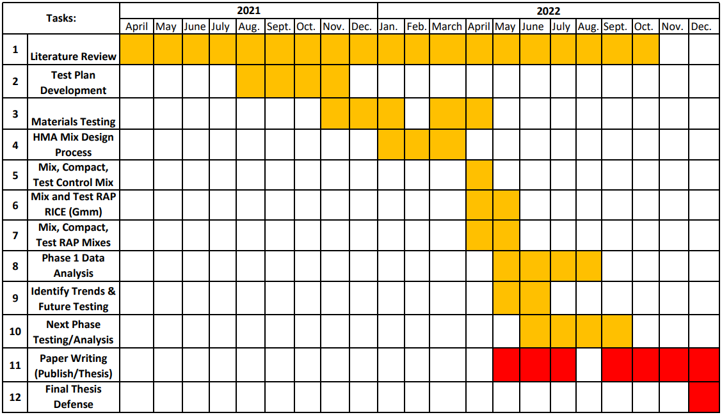
Research Schedule

Slide 60
Questions?
Notes:
That’s why I have future research scope.

